Slide 1
RP3 warranty process

Slide 2
Actassi system / RP3 warranty
To check if an installation is eligible for RP3 Actassi system warranty, Schneider Electric has designed a PoE calculator tool to evaluate
Cable heating in bundles
Worst case insertion loss
This tool is an Excel file which name is:
yymmdd-Schneider Electric Actassi PoE calculator.xlsx *
* yy = year, mm = month, dd = day of the file release
The specifier sets all the parameters for the worst case configuration.
Those parameters are:
The characteristics of the patch cords and cable used
The length of the horizontal cable
The size of the bundles
The ambient temperatures
Pathway type and dimensions

Slide 3
Tool instructions for RP3 warranty

Slide 4
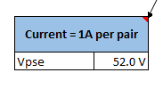
Tool instructions for RP3 warranty
1- Ensure the current is set to 1 Amp per twisted pair

Slide 5
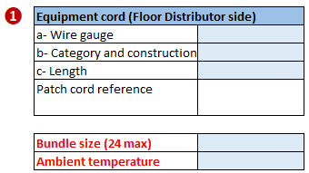
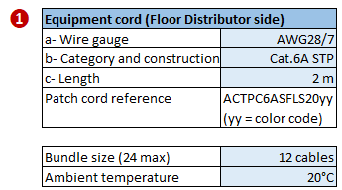
Tool instructions for RP3 warranty
2- Enter the settings for the patch cord on floor distributor side
Fill the blue cells

Slide 6
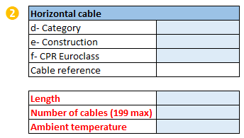
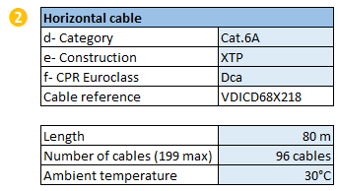
Tool instructions for RP3 warranty
3- Enter the settings for the horizontal cable
Fill the blue cells

Slide 7
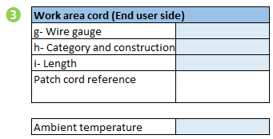
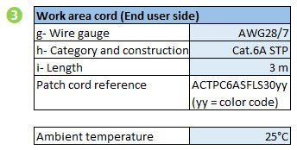
Tool instructions for RP3 warranty
4- Enter the settings for the work area cord
Fill the blue cells

Slide 8
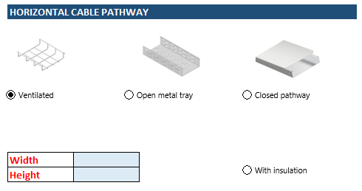
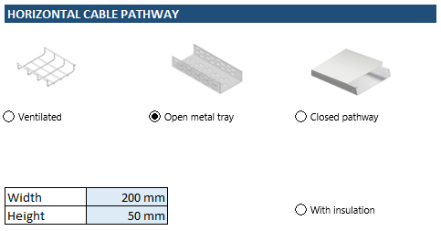
Tool instructions for RP3 warranty
5- Select the type and size of the pathway
Fill the blue cells and select the right pathway

Slide 9
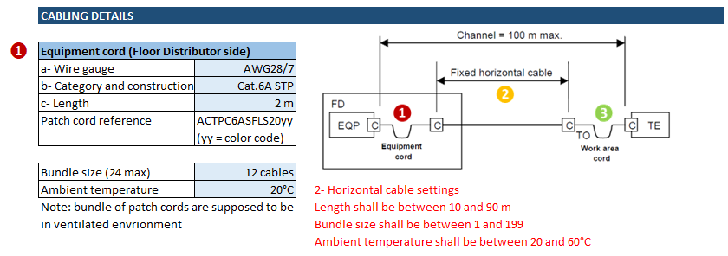
Tool instructions for RP3 warranty
6- Read the messages in red and correct the settings

Slide 10
Tool instructions for RP3 warranty
7- Final result
This configuration is eligible for RP3
Those configurations are not eligible for RP3 (cause written in red)

Slide 11
Tool instructions for RP3 warranty
8- Prepare the documents for Schneider Electric Front Office
Save the Excel file in pdf format for each critical configurations and attach them to the warranty folder
For the page settings, select the landscape configuration and scale to 1 page

Slide 12
PoE calculator for given applications

Slide 13
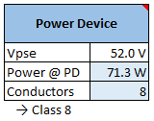
PoE calculator for given applications
1- Select Power Device, the expected power @ PD and the number of conductors

